Slide 1
Fitness Buddy ai agent
IBM HACKATHON PROJECT
Presented By:
Student name : Apurv Singh Rao
College Name & Department : Parul University / Cse - AI

Slide 2
OUTLINE
Problem Statement
Technology used
Wow factor
End users
Result
Conclusion
Git-hub Link
Future scope
IBM Certifications

Slide 3
Problem Statement
In today’s fast-paced world, many individuals struggle to maintain a healthy lifestyle due to lack of personalized guidance, time constraints, and inconsistent motivation. Traditional fitness solutions often require expensive subscriptions, in-person consultations, or rigid schedules that don't adapt to personal preferences or daily routines.
There is a growing need for an accessible, friendly, and intelligent virtual assistant that can provide on demand fitness advice, healthy lifestyle suggestions, and basic nutrition guidance—all tailored to individual needs and available at any time.
Fitness Buddy aims to solve this problem by offering a conversational, AI-powered health and fitness coach that can:
Recommend home workouts and routines based on user input.
Provide motivational tips and daily fitness inspiration.
Suggest simple, nutritious meal ideas.
Encourage habit-building and consistency.

Slide 4
Technology used
IBM cloud lite services
Natural Language Processing (NLP)
Retrieval Augmented Generation (RAG)
IBM Granite model

Slide 5


IBM cloud services used
IBM Cloud Watsonx AI Studio
IBM Cloud Watsonx AI runtime
IBM Cloud Agent Lab
IBM Granite foundation model

Slide 6
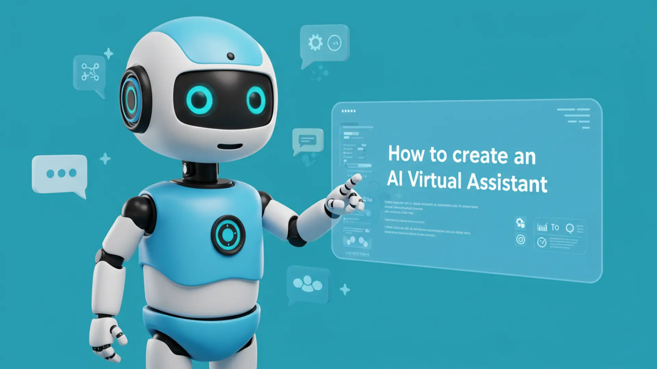
Wow factors
The virtual assistant adapts in real-time to user input, tailoring workout and meal suggestions dynamically. Many apps give generic advice, but Fitness Buddy listens, understands, and adapts—just like a real coach.
Unique features:
It uses natural language understanding to interact with users conversationally.
Hosted on IBM Cloud Lite—users can access the coach 24/7 without expensive infrastructure.
Encourages healthy habits with consistency tips, positive reinforcement, and gentle reminders.
Suggests routines based on what users have available (like “no equipment” or “5 minutes only”).
Gives simple, nutritious meal ideas using ingredients users mention.

Slide 7

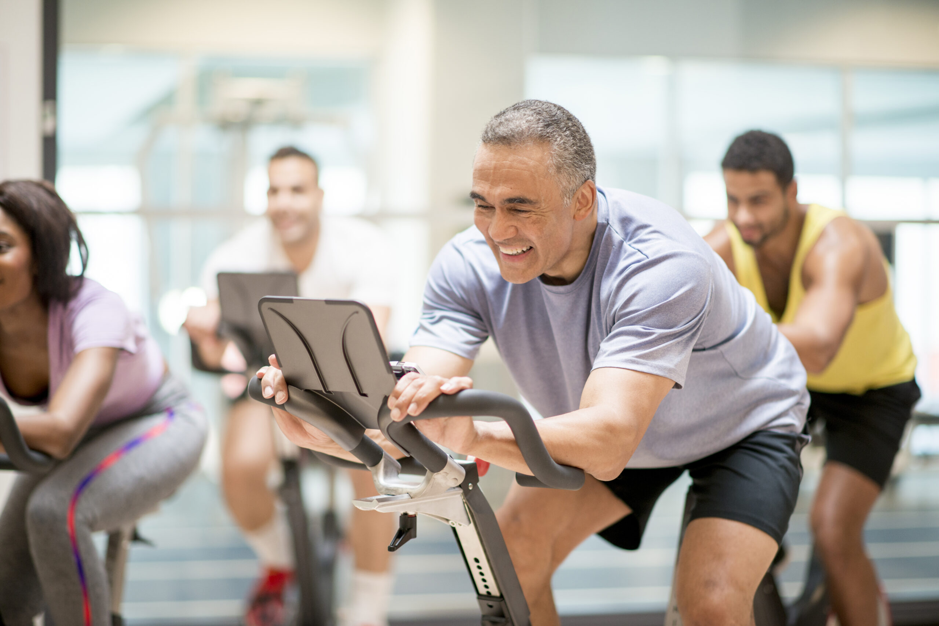


End users
Everyday People
Fitness Instructor
Athletes, Pro-Players
Students

Slide 8
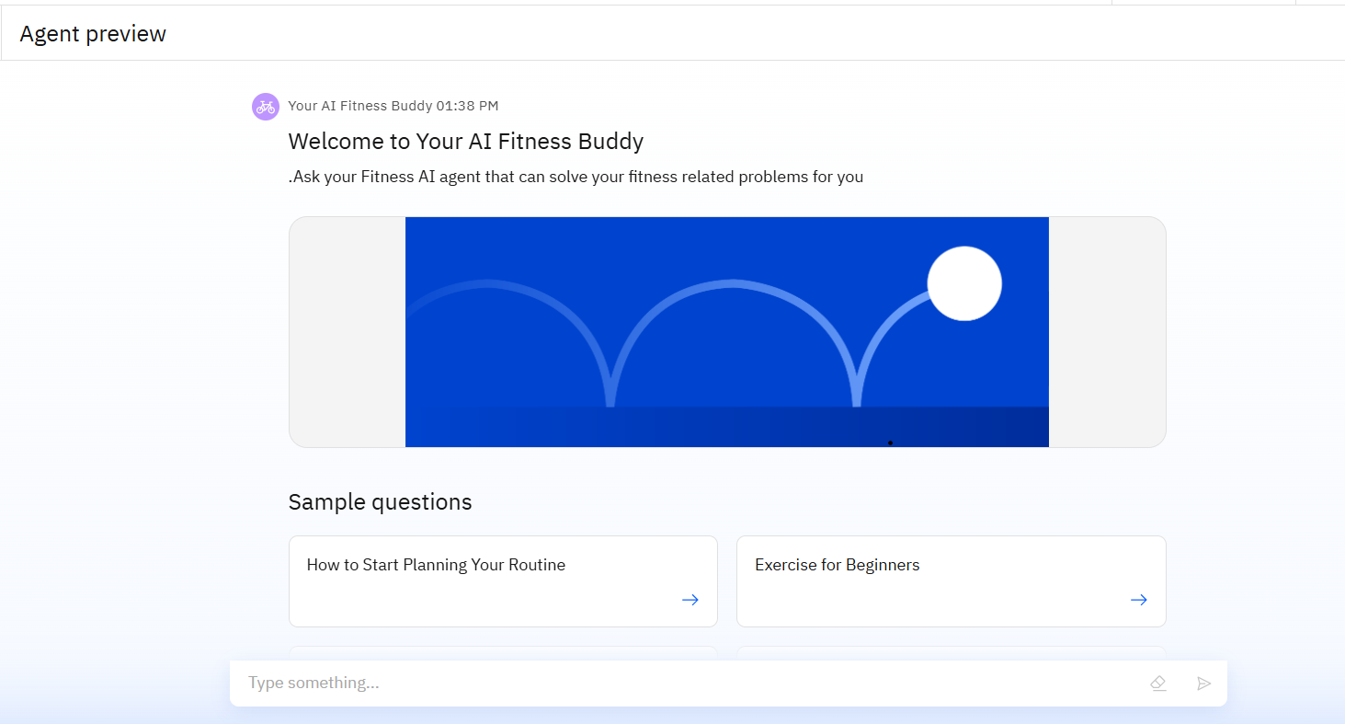
Results
Fitness Buddy successfully demonstrates how AI, when combined with personalized fitness and nutrition support, can lead to healthier lifestyles, improved motivation, and greater accessibility—without the need for expensive infrastructure or rigid routines.

Slide 9
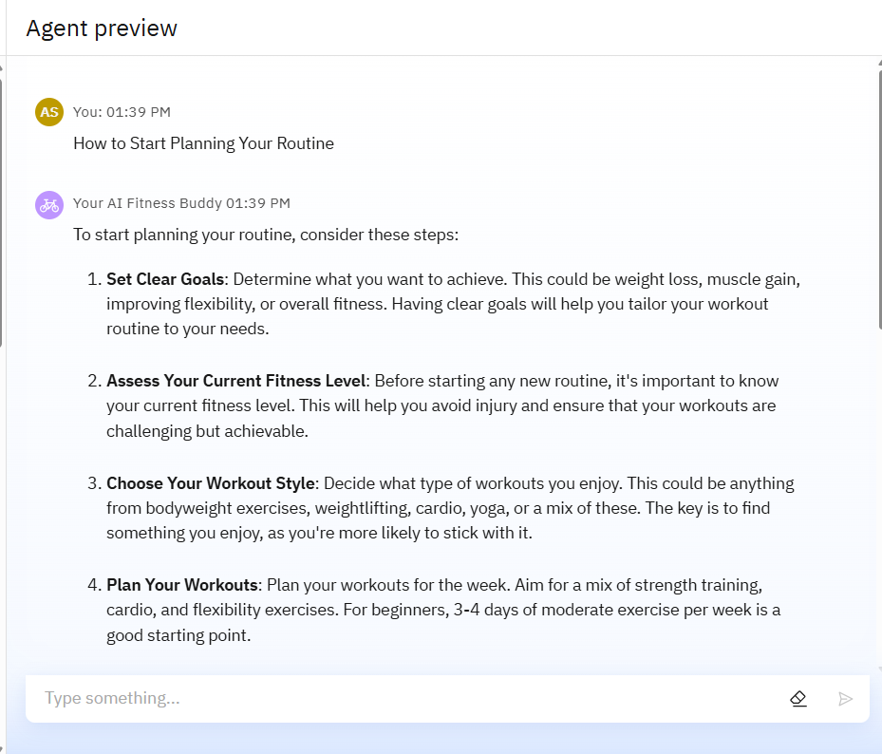
Results
By removing the need for expensive trainers or gym memberships, Fitness Buddy makes health guidance more inclusive and affordable.
Using IBM Cloud Lite or IBM Granity allowed for reliable performance, remote access, and real-time interaction with minimal infrastructure cost.
Suggests routines based on what users have available (like “no equipment” or “5 minutes only”).

Slide 10
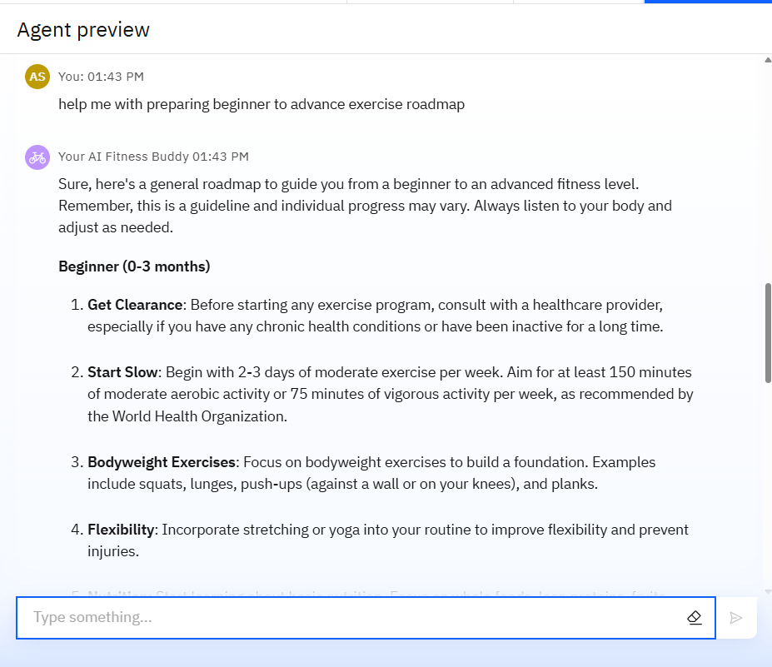
Results
Gives simple, nutritious meal ideas using ingredients users mention.
No premium subscription or hidden costs—fitness support is democratized. Makes wellness accessible to all, not just the affluent—aligned with social good.
The chatbot interface makes users feel supported and understood, improving their consistency and interaction over time.

Slide 11
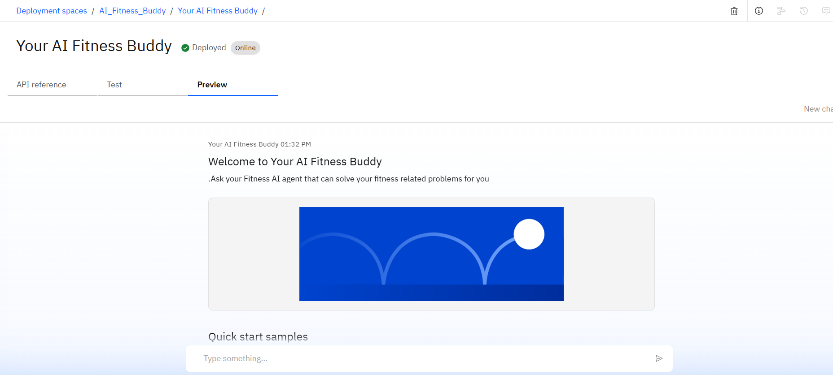
Results
Deployed AI Agent

Slide 12
Conclusion
Users benefit more from personalized, conversational recommendations than from one-size-fits-all workout apps.
he chatbot interface makes users feel supported and understood, improving their consistency and interaction over time.
Using IBM Cloud Lite or IBM Granity allowed for reliable performance, remote access, and real-time interaction with minimal infrastructure cost.

Slide 13
GitHub Link
https://github.com/raoapurv007/Fitness-Buddy-AI-Agent.git

Slide 14
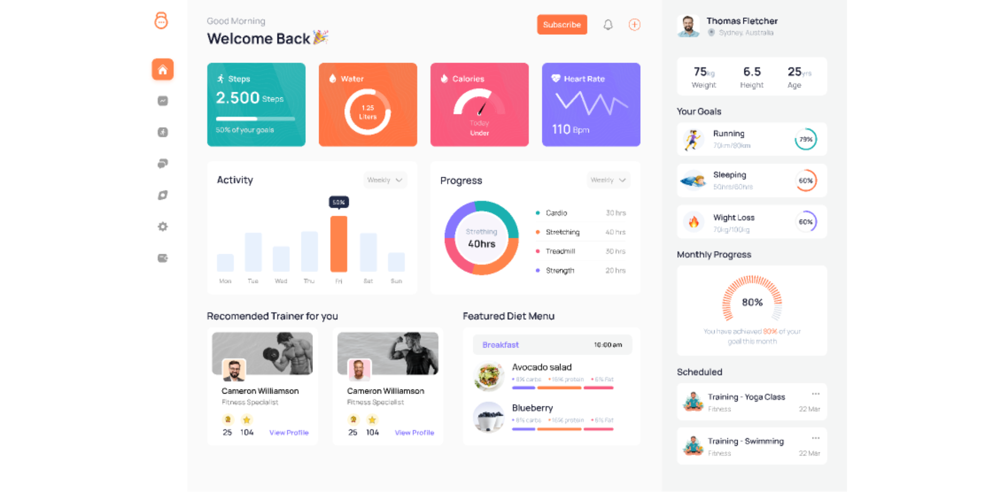

Future scope
Progress Tracking with Visual Dashboards
Voice-Activated Research Assistant
Real-Time Collaboration Features
Mobile App Deployment
Image-Based Food & Exercise Recognition
Community & Social Features

Slide 15
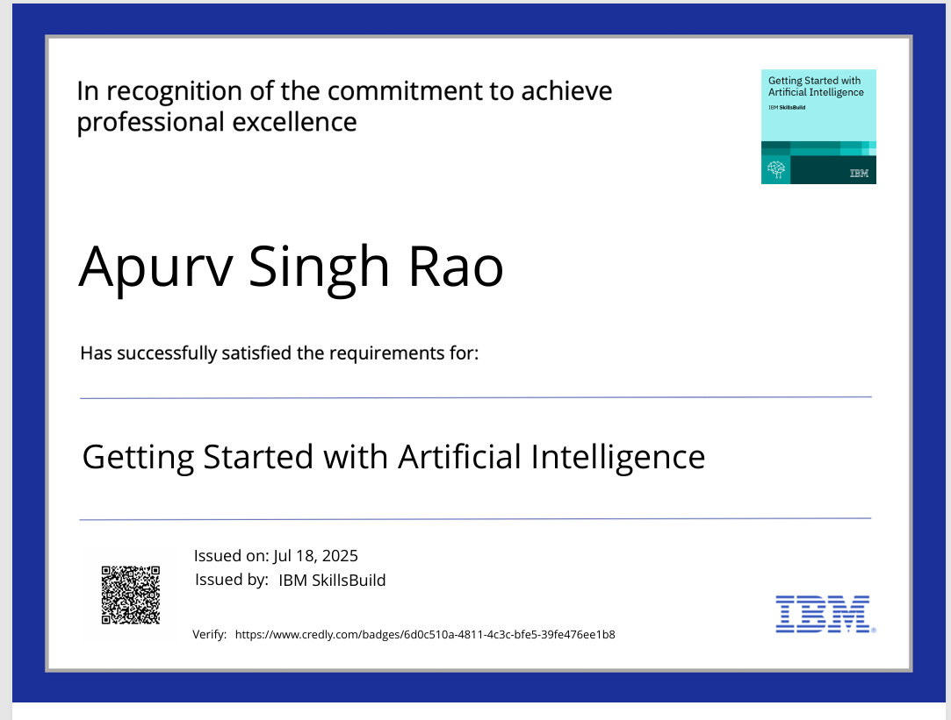
IBM Certifications

Slide 16
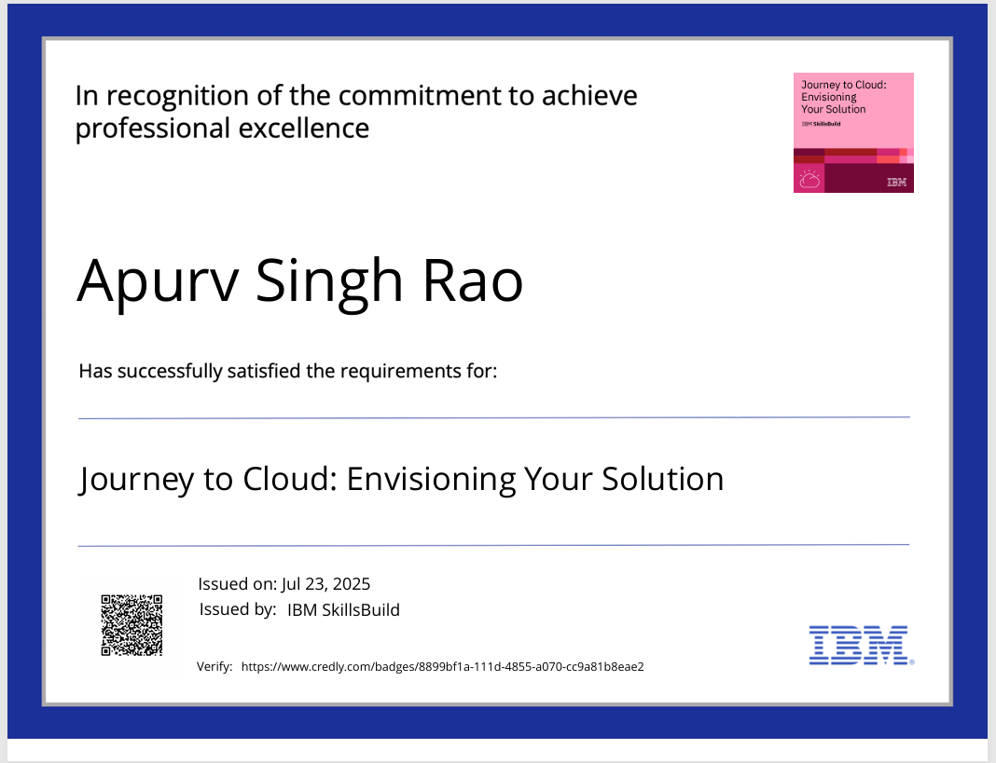

Slide 17
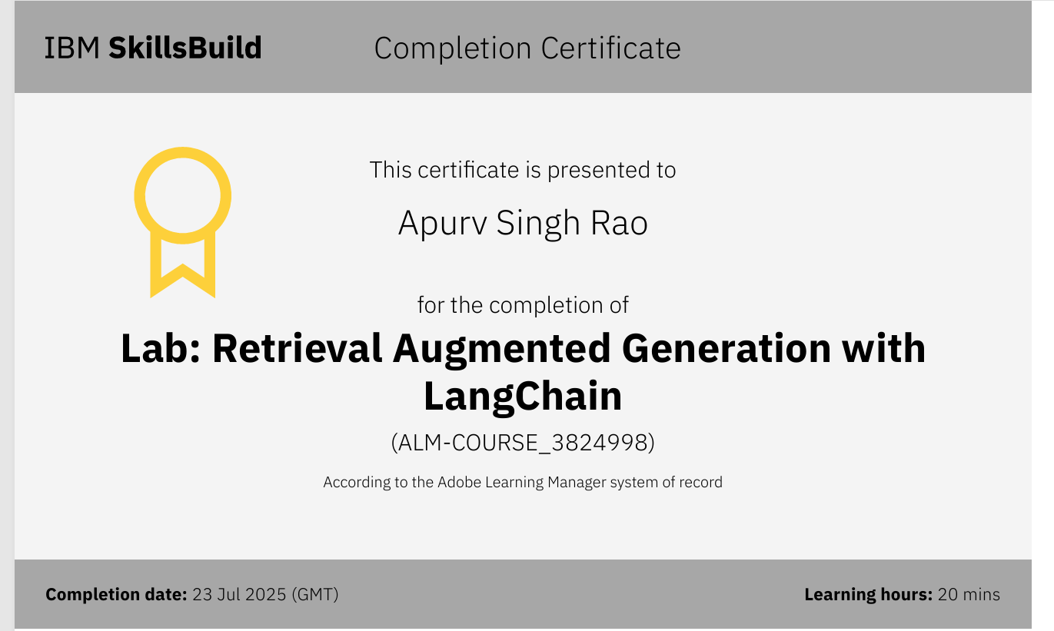

Slide 18
THANK YOU

